Slide 1

select() Systemcall
- I/O Multiplexing

Slide 2
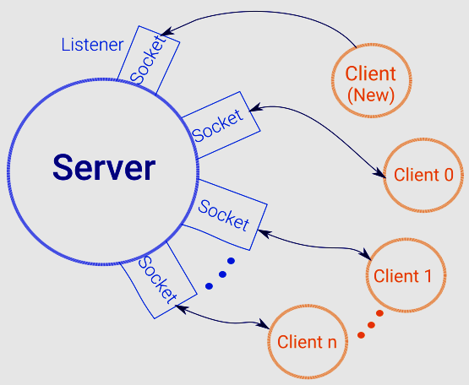
TCP Socket Programming Model

Slide 3
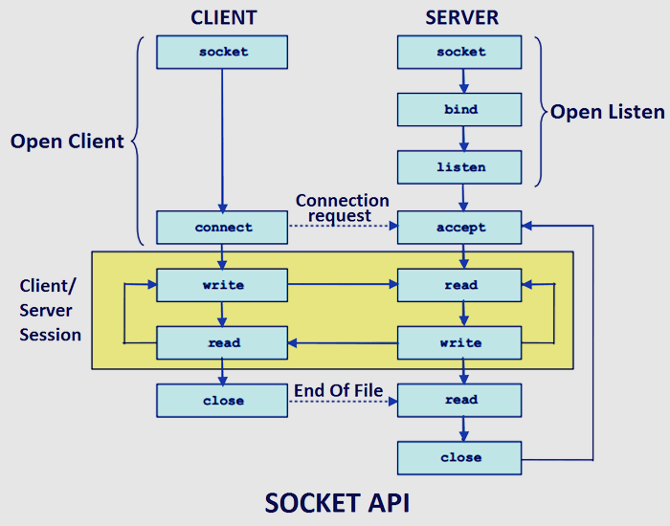
TCP Socket Programming Model
Notes:
Note that at the end of client communication, its sending End of File and is being read by server with 0 bytes of data. Need to handle this with reading 0 bytes

Slide 4
select() Systemcall
select() allows a program to monitor multiple file descriptors
Waits until one or more of the file descriptors become "ready" for some class of I/O operation (e.g., input possible).
A file descriptor is considered ready if it is possible to perform a corresponding I/O operation (e.g., read or write)
select() can monitor only file descriptors numbers that are less than FD_SETSIZE (which is typically 1024 on a 32-bit architecture)

Slide 5
File Descriptor Sets
Select() system call watches 3(Three) independent sets of I/O file descriptors
readfds
The file descriptors listed in this will be watched to see if characters (data) become available for reading
writefds
The file descriptors listed in this will be watched to see if space (I/O Buffer) is available for write
exceptfds
The file descriptors listed in this will be watched for exceptional conditions
Notes:
For Write, I/O buf should not be full.

Slide 6
Macros in select() Systemcall
Four macros are provided to manipulate the sets.
FD_ZERO() clears a set
void FD_ZERO(fd_set *set);
FD_SET() adds a given file descriptor to a set
void FD_SET(int fd, fd_set *set);
FD_CLR() removes a given file descriptor from a set; this is useful after servicing the client post receiving the data on it
void FD_CLR(int fd, fd_set *set);
FD_ISSET() tests to see if a file descriptor is part of the set; this is useful after select() returns (i.e, when it comes out of loop)
int FD_ISSET(int fd, fd_set *set);
Notes:
void FD_CLR(int fd, fd_set *set);
int FD_ISSET(int fd, fd_set *set);
void FD_SET(int fd, fd_set *set);
void FD_ZERO(fd_set *set);

